Slide 1
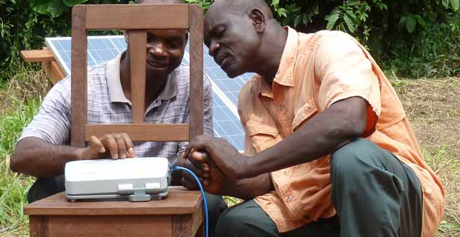
Software Tools for Translating

Slide 2

Free
Software
Free
Resources
Free
Storage
and Use
on WACS

Slide 3
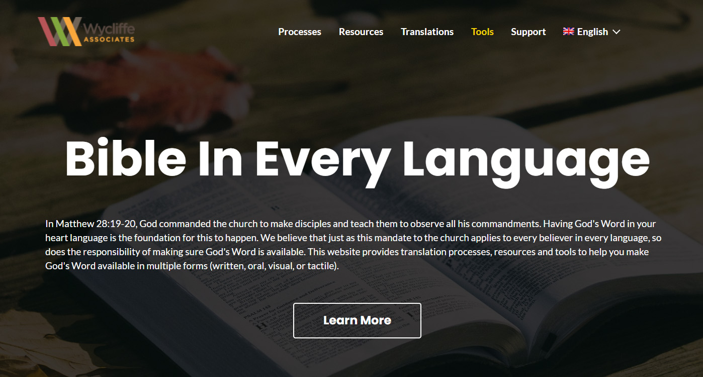
bibleineverylanguage.org

Slide 4



Translation Formats
writing system?
mp3 or smart phone?
?
Written
Oral
Local Church

Slide 5
?
Have you considered…?

Slide 6




Free Technical Tools for Written Translations

Slide 7
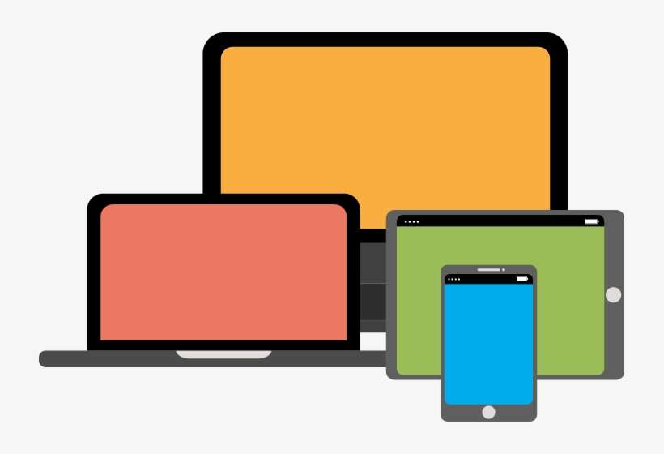




Downloadable
1
2
Checking Resources Included!

Slide 8

Downloadable
Checking Resources Not Included

Slide 9
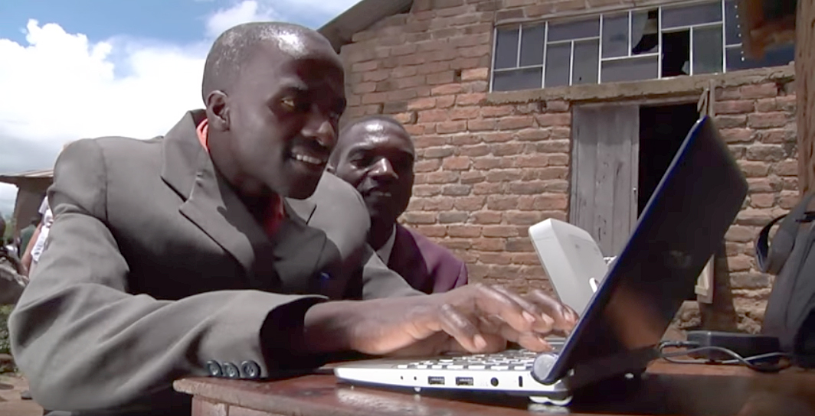

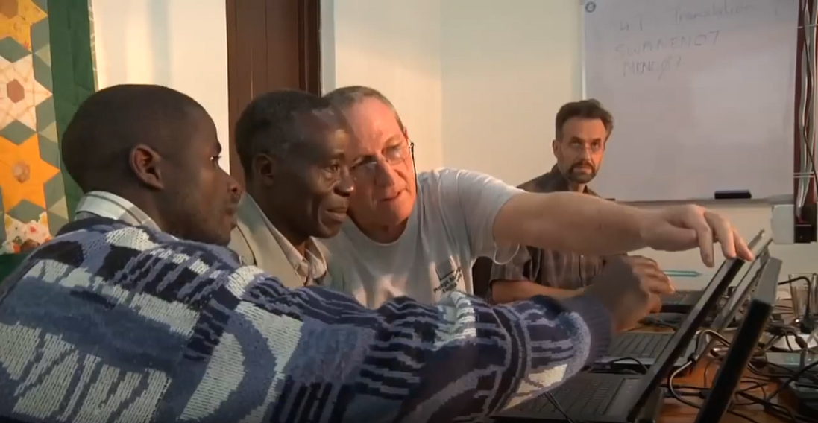
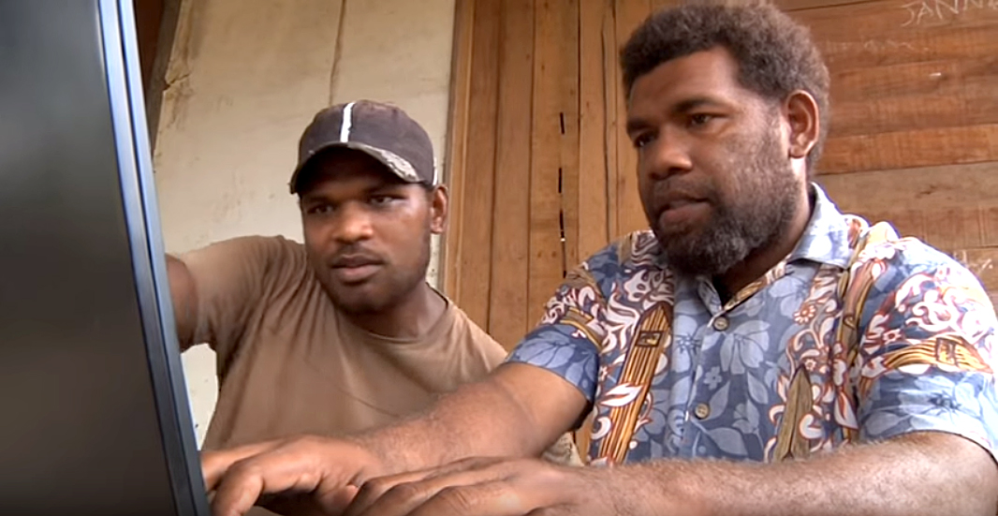
V-MAST Online Network
Checking Resources Available Online!

Slide 10
Downloadable
Only one computer needed
Checking resources included
Downloadable
Simplest one to use
No checking resources included
All translators must work online
MAST steps built in
Checking resources included

Slide 11
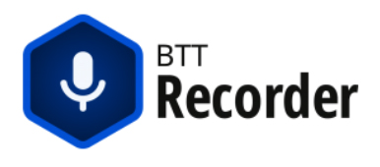

Free Technical Tools for Oral Translations
Orature

Slide 12
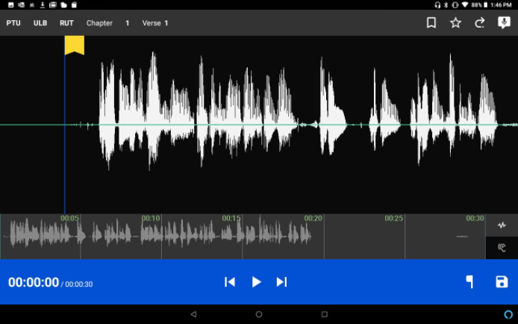
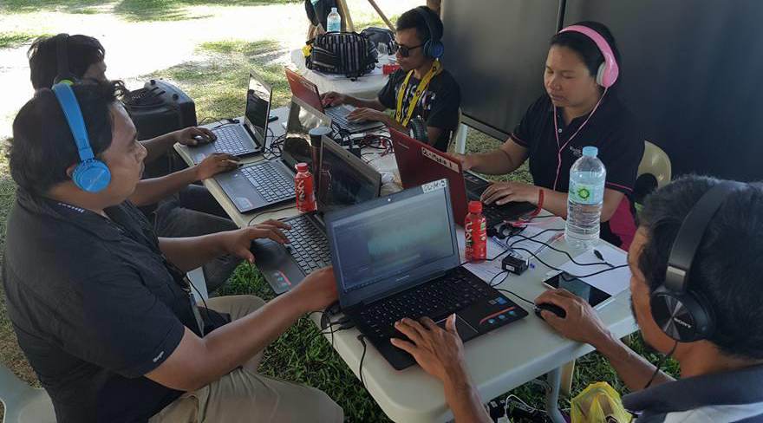

Slide 13
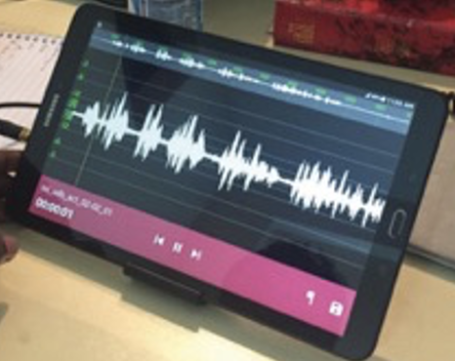
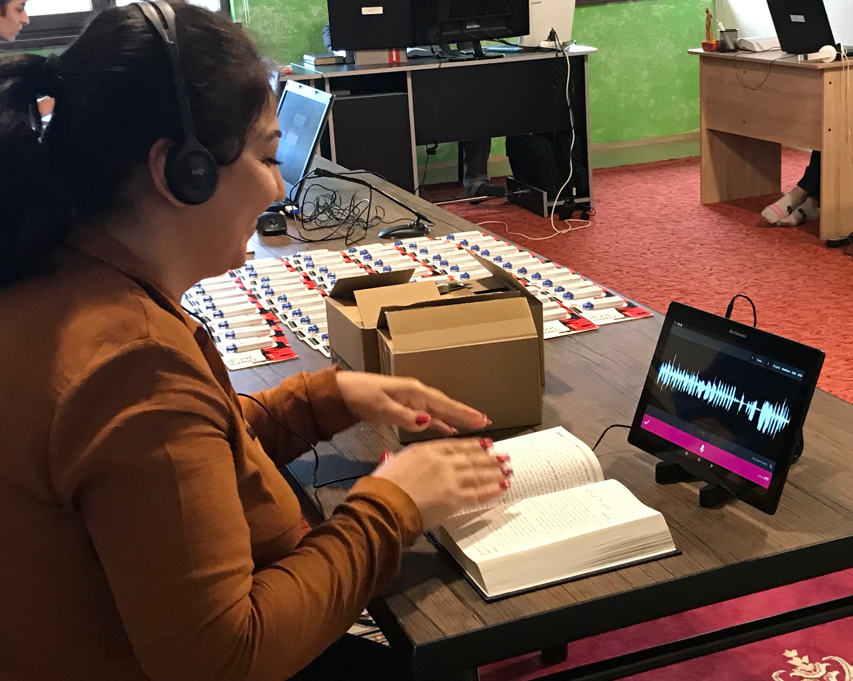
Orature

Slide 14
Simplest to use
Users must download audio source files
Can also be used for recording written translations
Audio source files are built in
Orature

Slide 15
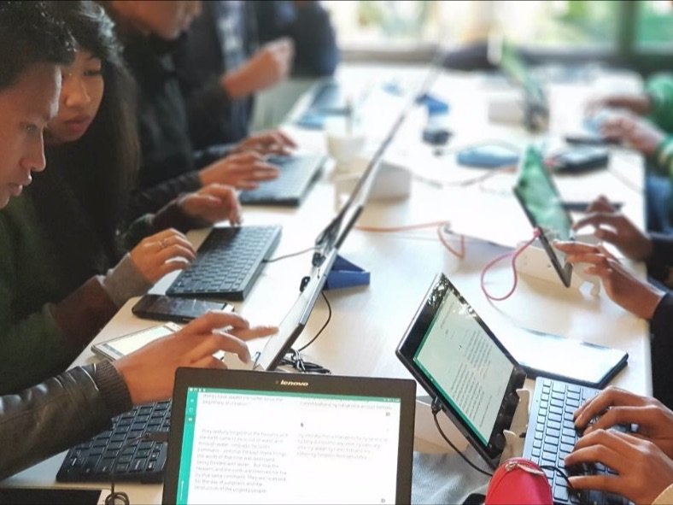
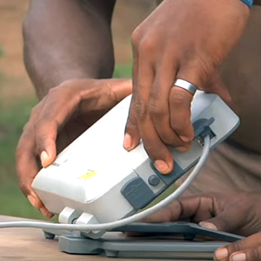
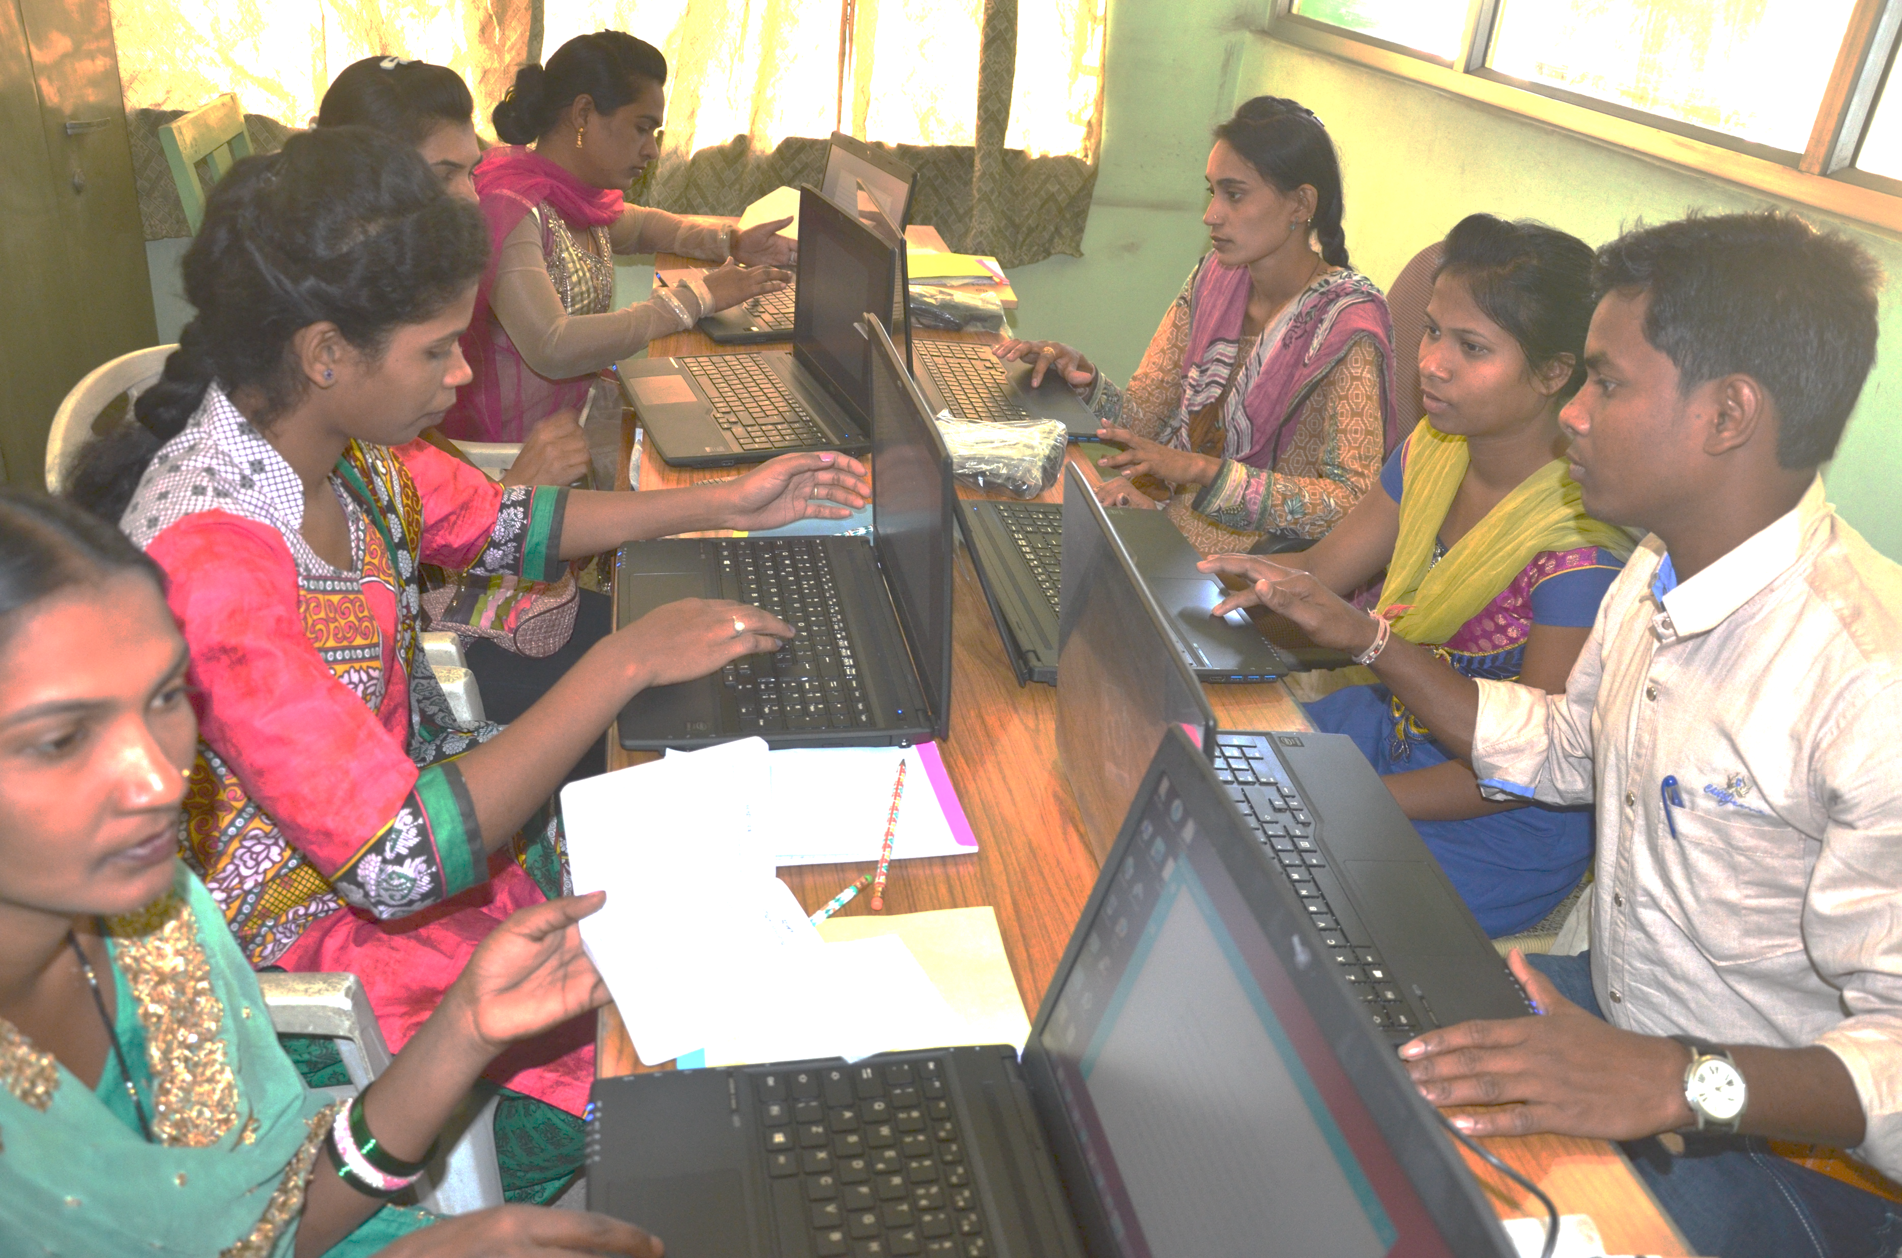
?
Consider:
Accessibility to laptops
Which tool works best?
Accessibility to good internet
Computer literacy of translators

Slide 16
Orature

Slide 17

?
Benefits?
Challenges?
Local Church
Psalm 102:18

Slide 18


